Slide 1
ONUG Open Networking Use Cases
ONUG Working Group
Traffic Monitoring/Visibility POC Discussion
Conference call on December 14, 2015, 2:30pm Central
Notes:
----- Meeting Notes (1/31/13 11:55) -----

Slide 2
Today Discussion
Where we are now / What is the goal again:
Still see the gap on the industry – managing the SDN (and what differ than the hardware underlaying technology (like SPAN / RSPAN / ERSPAN) -- Question: Are this slowing everybody on adopting software based networking (SDN)? (like to be a statement.. Or is there other reason?)
Refresh Memory (keep in mind: multivendor – interoperability)
Top 3 priority requirements:
Traffic Visibility and Time correlation on the source to be consume by the state/tools
Filtering / Controlling (QoS)
Traffic Management (ie, redirection, deduplication)
Outcome:
Multivendor POC (out of the use cases and requirement) (is that satisfy business requirement?) - Video for the vendor (platform for the vendor to do the showcase)
Hackaton
Common Format – API? Expanding Openflow (Openflow usecase)..(how we control the monitoring traffic) – to be consume by the tools (it will be big data problem) -- What is the requirement for the common format?
Others:
fitting “common format” into the “Software Managed Infrastructure” Stack . Fit into Infrastructure as Code (IaaC)
Use Cases input

Slide 3
Common Format Requirement
Has to be time based synchronization
Common Control API (Filtering, steering the traffic, QoS-ing, process control (CPU/Memory)) - southbound
Common format to define the application and embed that information through the common control API to each device
Common SPAN/Remote SPAN mechanism (jumping from one platform to others) – east west communication
Common format to be passed to the tools/network state for processing of the data -- northbound
Has to be secure communication
Auditable / logging capability

Slide 4
Appendix – Previous Meeting Notes

Slide 5
Attendee Today
Todd Simmer, Enso
Travis Griffin, FedEx Tentative
Bob Natale, MITRE Tentative
Steve Lafrentz, Principal Financial Group
Sean Wang, University of British Columbia
Fred Lima, Visa
Jem Pagan, JNK Securities
Brian Ong, Navy Federal Credit Union

Slide 6
Timeline
Event / Milestone | Date
Kickoff Conference Call | December 14, 2015 2:30pm CT
Conference Call (Enterprise) | January ?, 2015 2:30pm CT
Conference Call (Enterprise) | February 8, 2015 2:30pm CT
ONUG Spring 2016, West Coast | May 2017

Slide 7
Refresh Memory -- Traffic Monitoring/Visibility
Problem Being Solved: Over & Underlay Traffic Filtering/Steering
Allows for highly customizable data capture and copy based on header and DPI matches
Automated/flexible traffic steering capabilities to monitoring tools
Limited SPAN/monitor port capacity on network switches
Polling schemes don’t scale
Lack of network traffic/flow visibility usage trends
Lack of scale: need visibility into 1,000s of flows
Open Networking Components:
Open API and Controllers + SDN Tap application provides SPAN functionality on arbitrarily large number of switch ports + SFLOW
White box networks to aggregate SPAN ports
Gap: Shadow network. Can’t monitor without big data network analytics, information visibility.
Providing all information about network infrastructure plant
Benefits: Over & Underlay Traffic Monitoring, Steering
Business unit self service
CapEx/OpEx relief
Network/traffic/flow visibility
Monitor Ports
filters
filters
Multiplexer
Tap Application
Service Node
Service Node
Delivery
User
Tooling

Slide 8
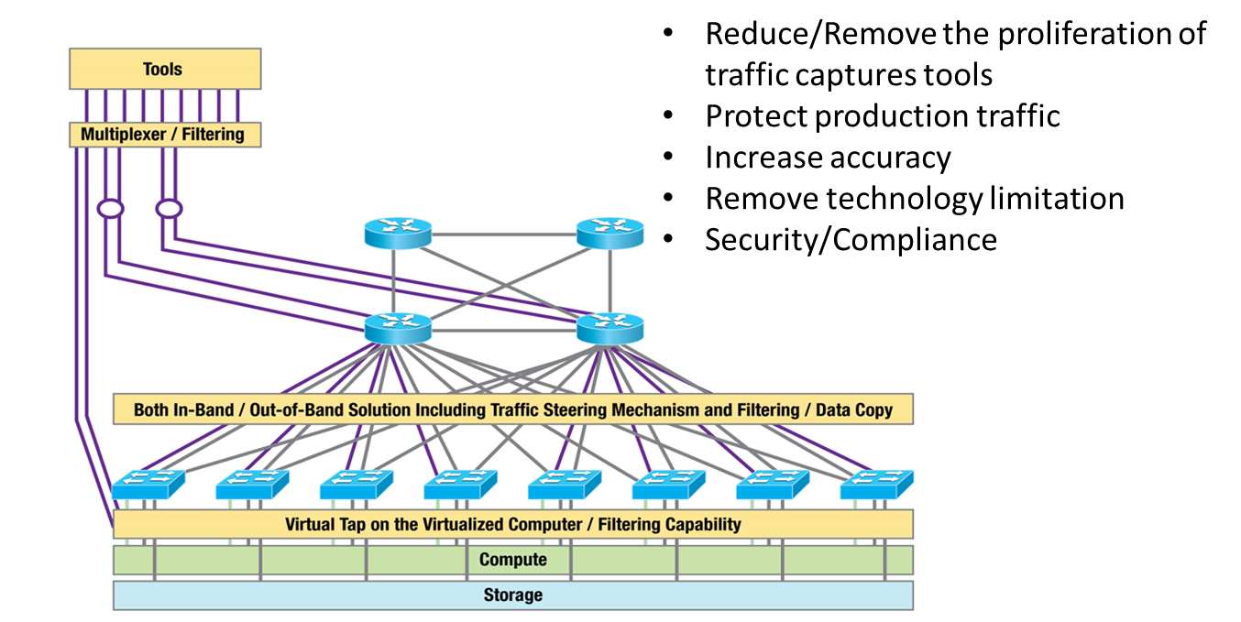
Desired Architecture

Slide 9
Top 10 Requirements
1. Commodity hardware based upon merchant silicon with either an open or propriety Switch OS.
2. Granular filtering based on 5-Tuple and/or even more., including Application signatures, and QoS marking capability.
3. Capability to work with both underlay and overlay protocols, providing independent filtering on either, and/or correlate both traffic.
4. Process data without impact to production flow/processing flow (CPU/Memory/Bandwidth).
5. Horizontal scalability with the capability of resource management feedback.
6. Must be able to locally process data and create traffic signaling/alerting, while executing defined traffic based actions.
7. Interoperability between vendors: integration and output that will support data collection integration. Open API for access and management (in/out).
8. Capability of Packet De-duplication/Packet Slicing/Data Masking and Application Recognition, including Packet Organization.
9. Must be Security and Compliance aware.
10. Multilayer visibility between underlay and overlay protocol use for management/SLA, monitoring/alerting, troubleshooting and reporting capabilities.
Notes:
Maxime 1, 2, 3, 6, 7 & 9

Slide 10
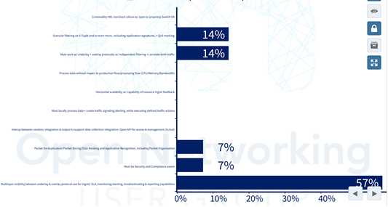
Recap on the Prioritization of the Requirement
Granular filtering based on 5-tuple and/or even more, including application signatures, and Quality of Service (QoS) marking capability.
Capability to work with both underlay and overlay protocols, providing independent filtering on either, and/or correlate both traffic.
Capability of Packet De-duplication/Packet Slicing/Data Masking and Application Recognition, including Packet Organization.
The ability to be Security and Compliance-aware.
Multilayer visibility between underlay and overlay protocol use for management/Service-Level Agreement (SLA), monitoring/alerting,troubleshooting and reporting capabilities.
Notes:
Maxime 1, 2, 3, 6, 7 & 9

Slide 11
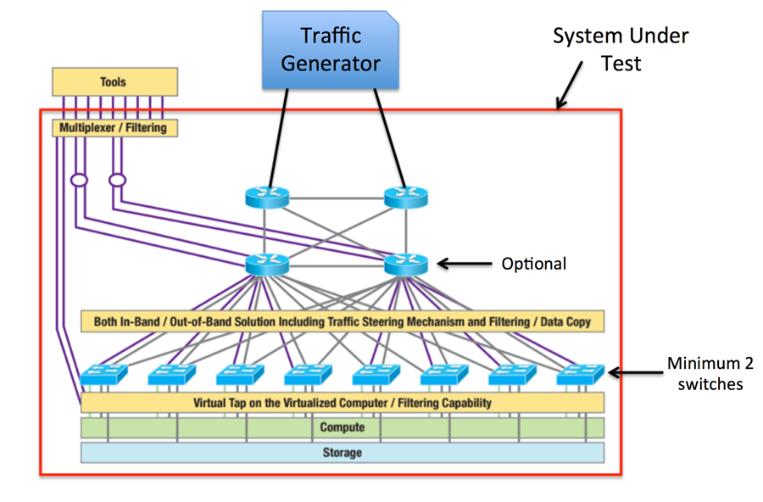
Validation Test Setup
Notes:
Maxime 1, 2, 3, 6, 7 & 9

Slide 12
Inter-relationships of ONUG Management Working Groups

Slide 13
ONUG Service Lifecycle Management Automation Framework
Network State
Tools Auto Config & Change Mgmt
SDN Federation
Net Monitoring

Slide 14
IT Service Lifecycle

